Slide 1
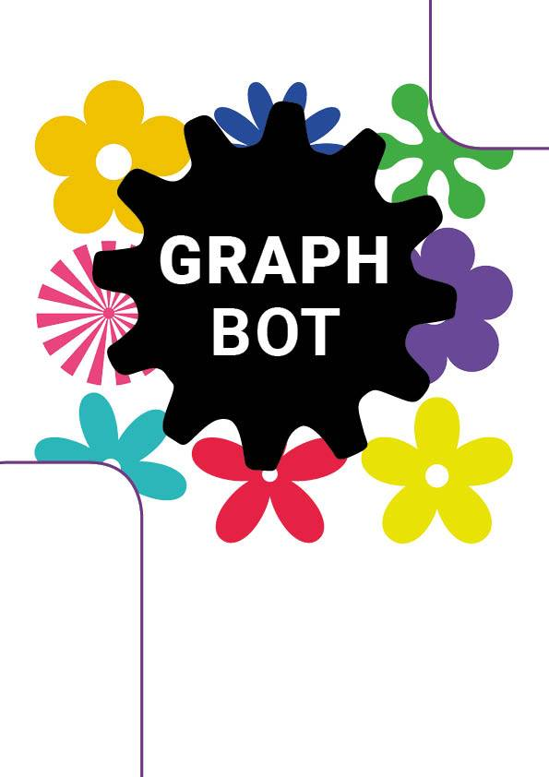
DRAWBOT
EPS 2016

Slide 2
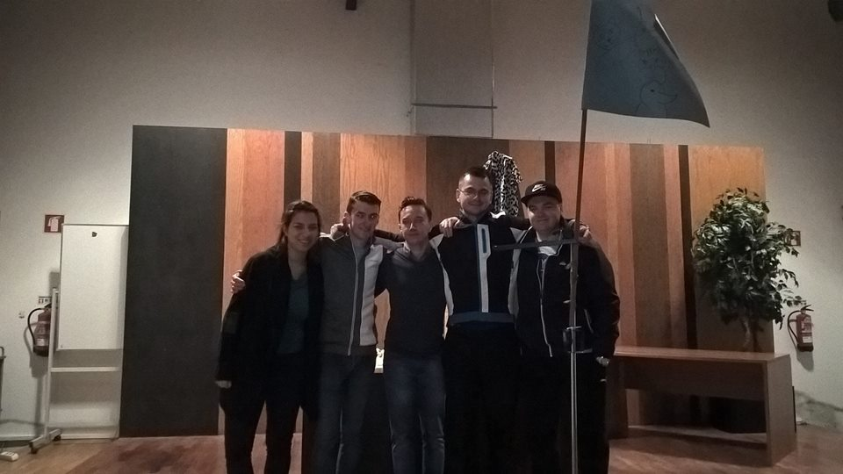
Our team
1
Notes:
Good afternoon everyone. We are the Primeira EPS Tribo.
My name is Adam[others says their names]
We had to face the threat of both cultural and academic differencies, but we have succeded to get along fine with each other
Today we will tell you more about the progres of our project.
To grab your attention, I would like to ask the female part of the audience:
have you ever wanted to obtain a robot designed especially for you?
Or have you ever thought about creating some artistic work in a convenient and original way?
WE hope you answered affirmative, and now let us introduce our product - The Drawbot

Slide 3
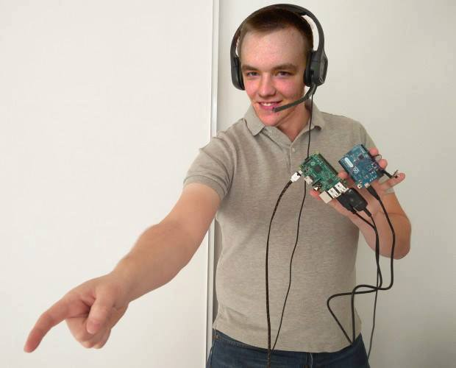
The problem
The goal is to design, develop and build
a drawing robot, commanded through sounds or gestures.
Notes:
Move on a plane
Work with distinct colors
Be aesthetically pleasing
Allow changing the drawing paper
Have as maximum dimensions 1.00 × 1.00 × 0.80 m
Reuse the provided materials
Use low cost hardware solutions
Use open source software
Comply with the Machine (2006/42/CE 2006‐05‐17), Electromagnetic Compatibility (2004/108/EC 2004-12-15), Low Voltage (2014/35/EU 2016-04-20), Radio Equipment (2014/53/EU 2014-04-16)and Restriction of the use of certain Hazardous Substances(ROHS)EU Directives

Slide 4
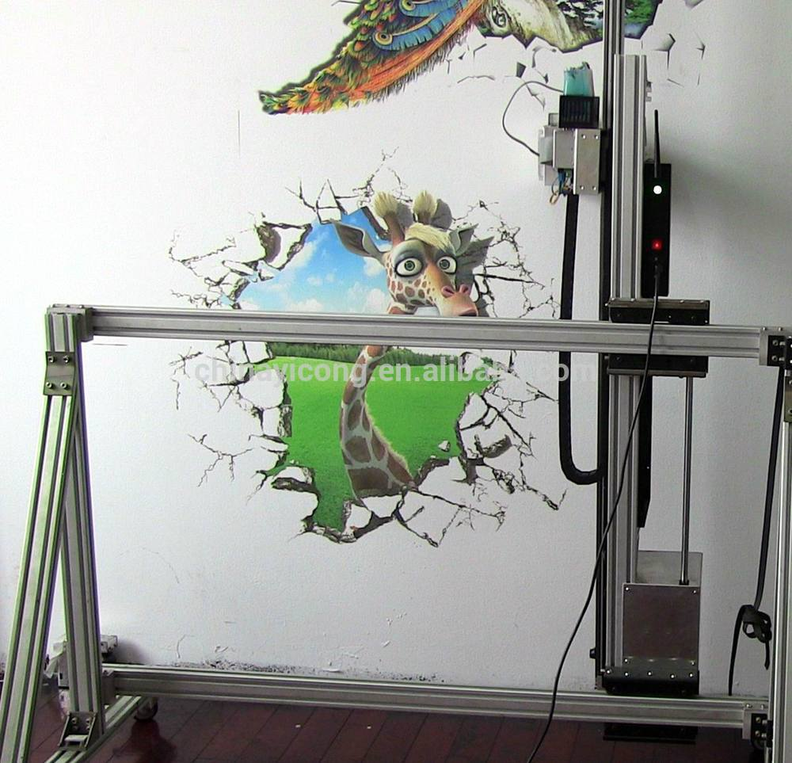
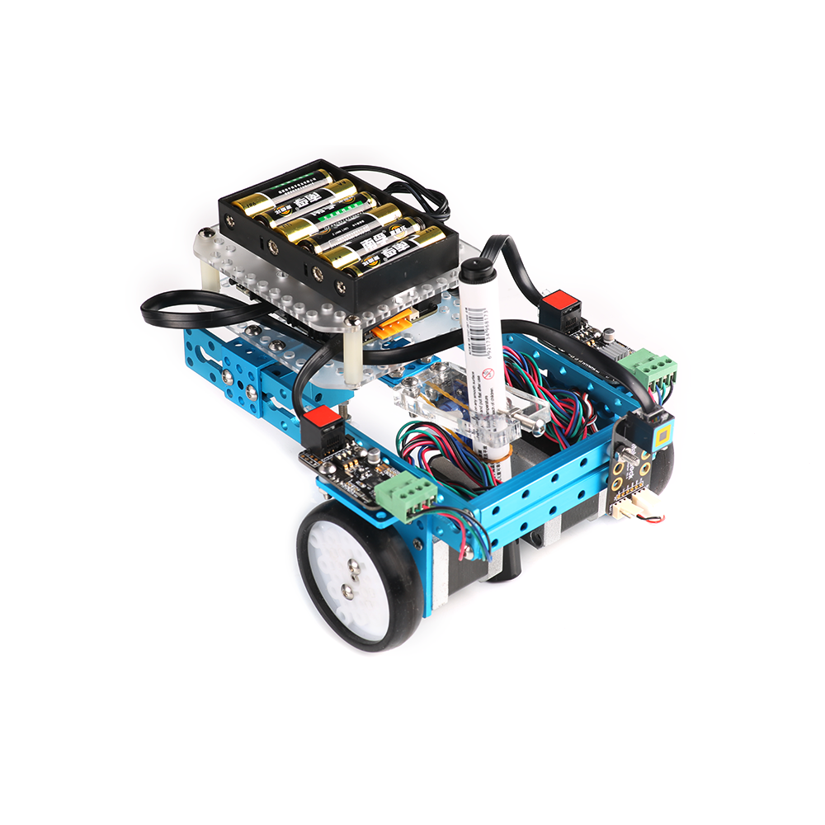
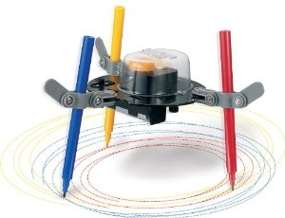
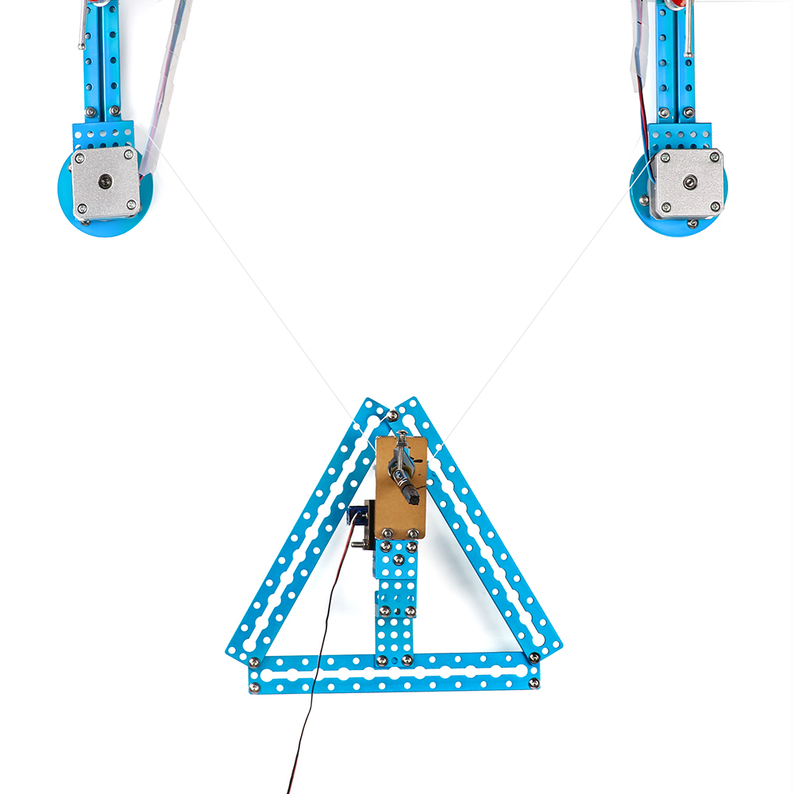
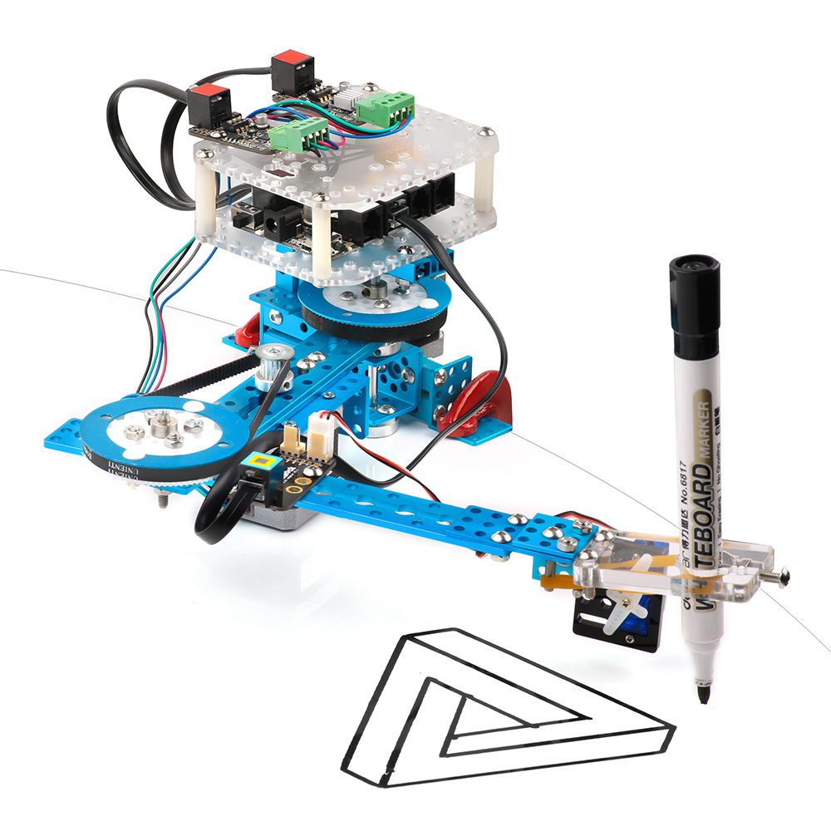
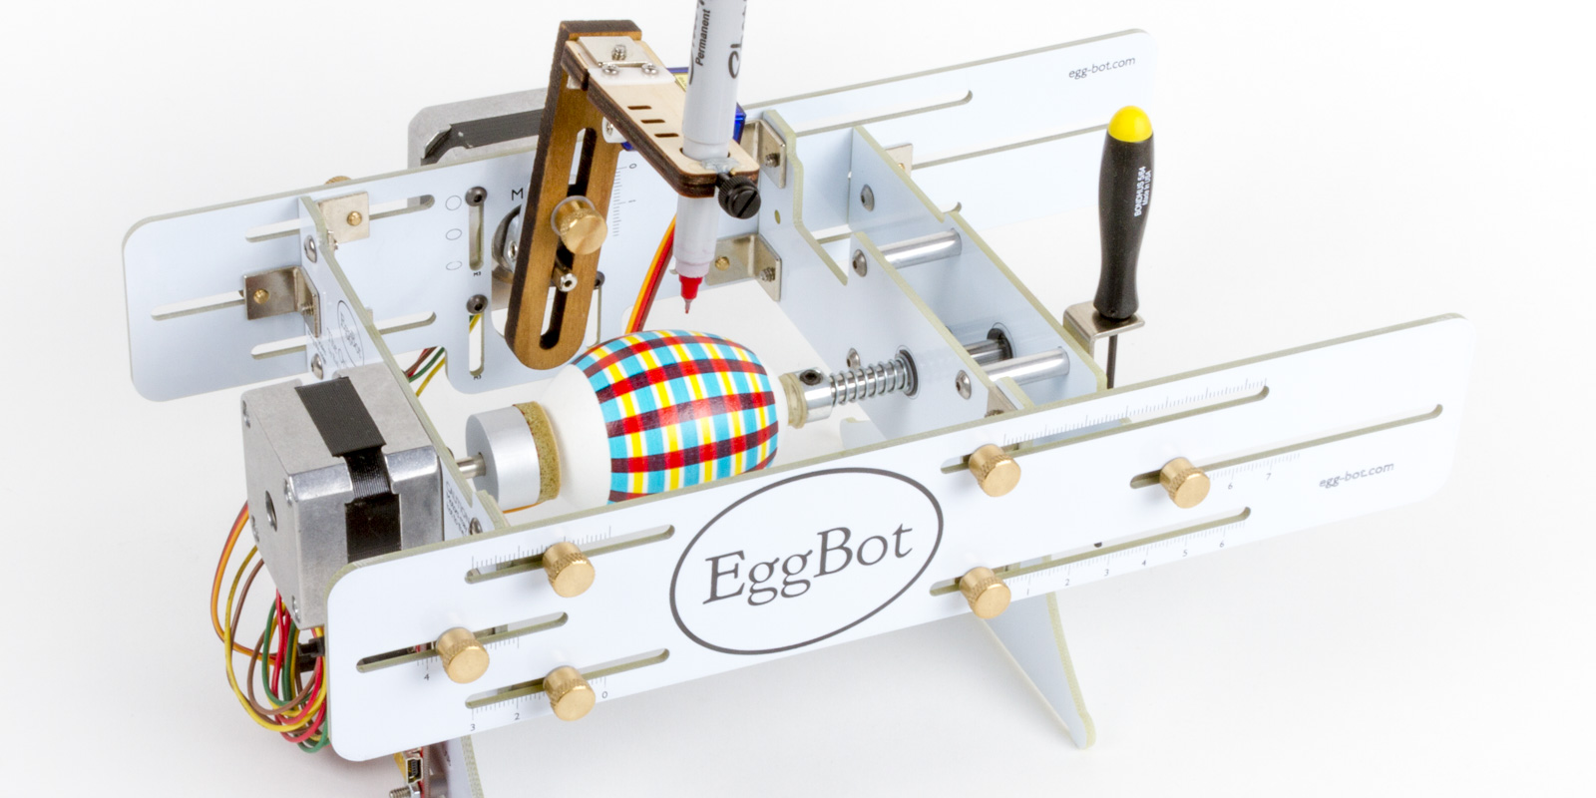
State Of The Art
-Sound
-Gestures
-Camera
-Smartphone Application
Notes:
Before designing our drawing robot, we researched products which are already on the market that are going to be similar to our final design. When researching, we found that there are many ways in which a drawing robot can function, such as:
-A robotic arm method such as the one shown here.
-A vibrating robot to move the pens.
-The EggBot, which allows the user to draw on difficult surfaces.
-A method known as the spider method which controls the pen with strings.
-A printer could also be used for creating art.
-Being driven on wheels on a plane.
Several different input techniques were also considered to command the robot, such as:
-Sound
-Gestures
-A camera to recognise colours which can relate to different actions
-An application for smartphones which can control the robot’s movement
Once we had researched and weighed up the advantages and disadvantages of each type of construction and input method, a decision could be made. We decided to use the wheels method as it allows the robot to draw over a large area on a plane fairly accurately. The input method we decided on was that of sound in which the user could give commands verbally to the robot. Now Nona will show you the 3D model of the robot.

Slide 5
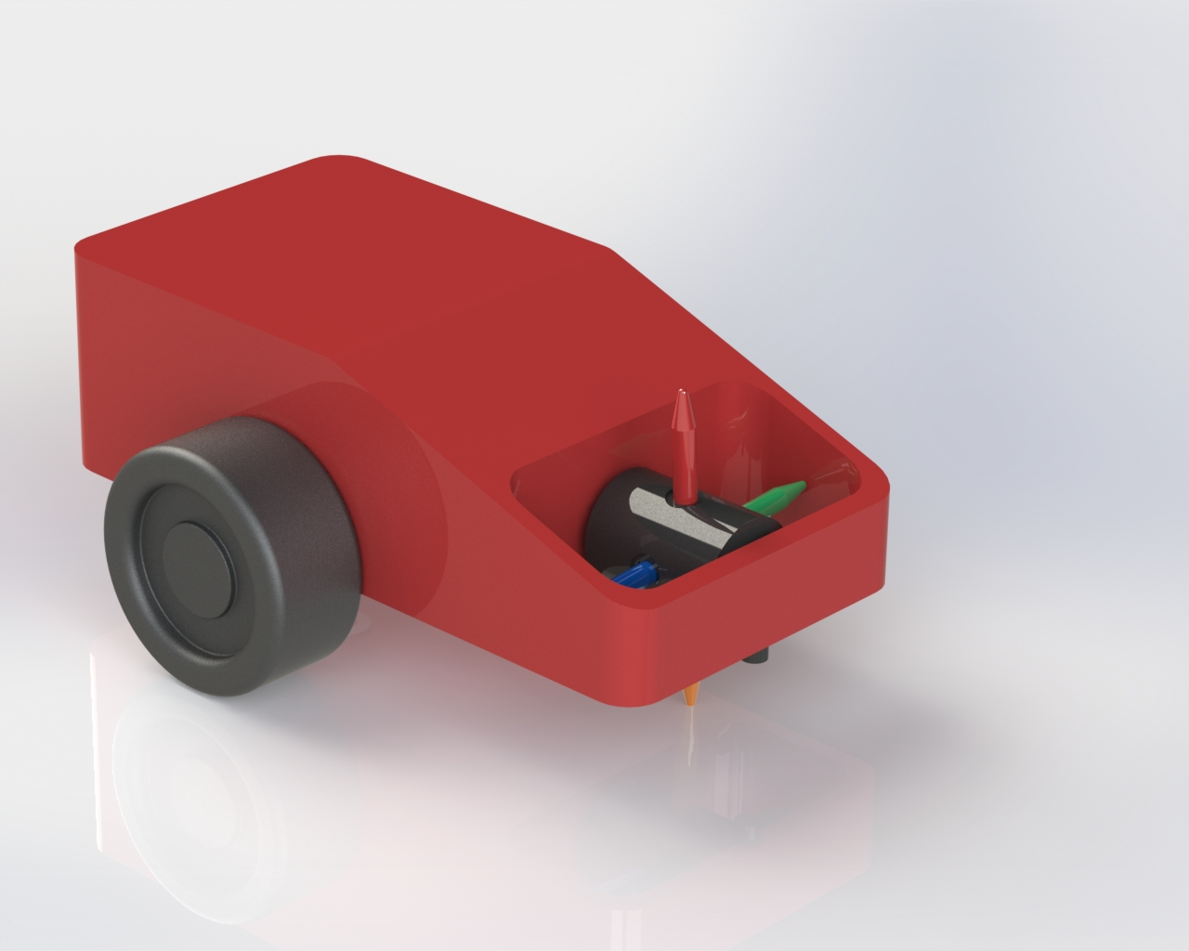
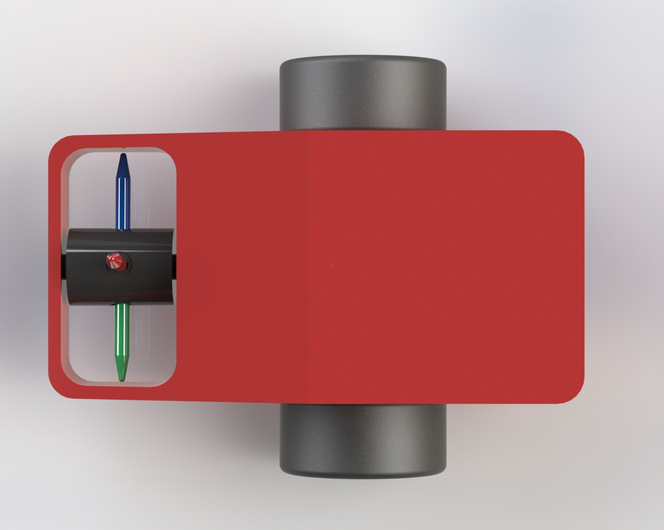
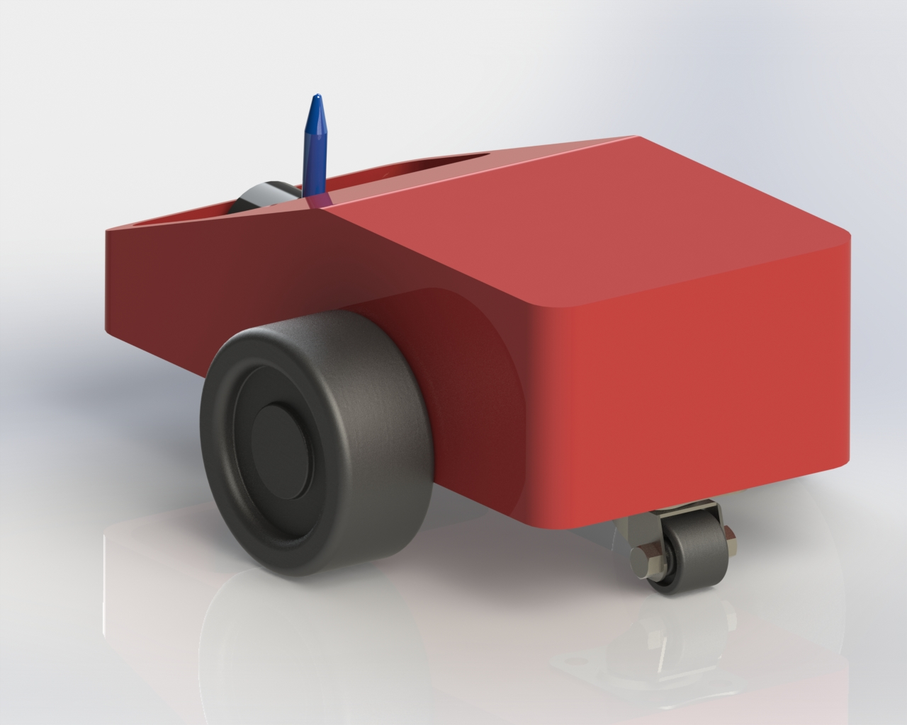
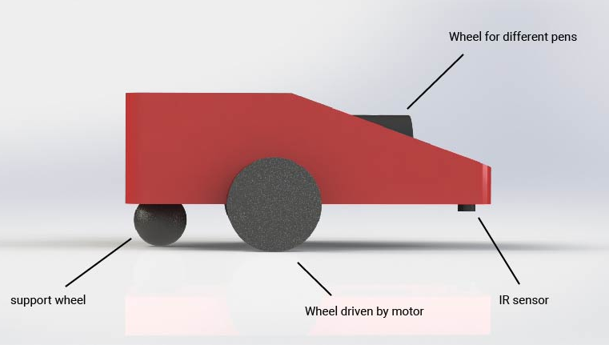
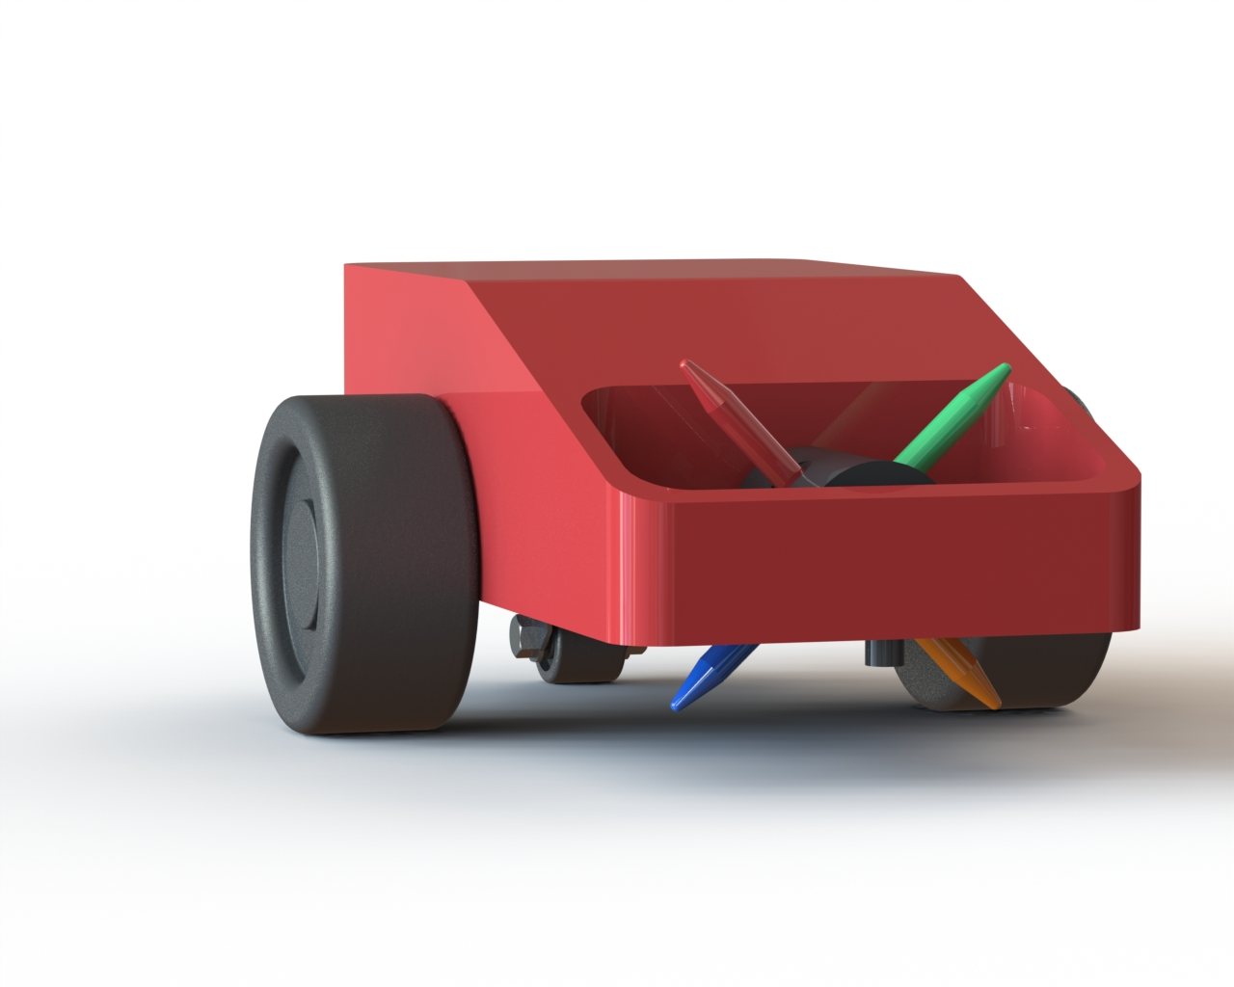
Notes:
As you can see we decided to build on the drawing robot with wheels. Our drawbot has three wheels. Two are driven by a motor, the third wheel is merely there for support. The infrared sensor detects the end of the drawing paper, making sure you don't draw on the floor or table. What makes our robot stand out is that it has the ability to change the drawing color automatically. It can hold up to four different colors. Another big difference is that it it is controlled by your voice . If you say forward it will go forward. Now let's watch a quick demonstration of the drawbot.

Slide 6
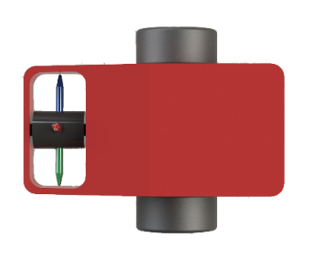
PS

Slide 7
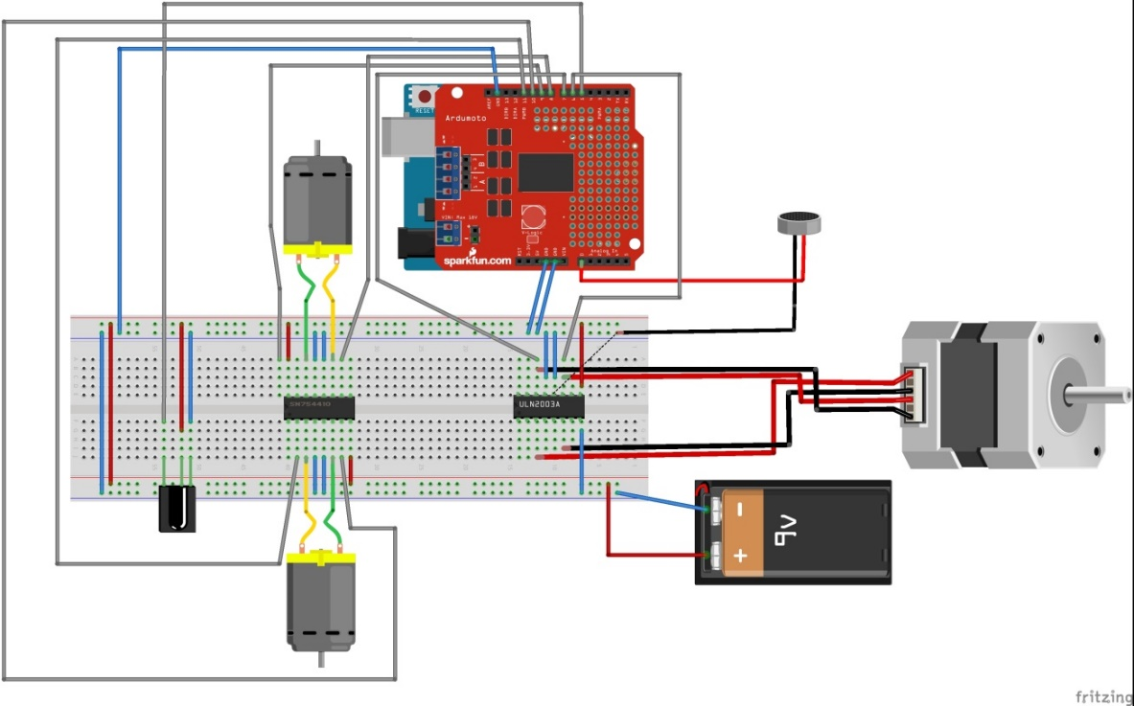
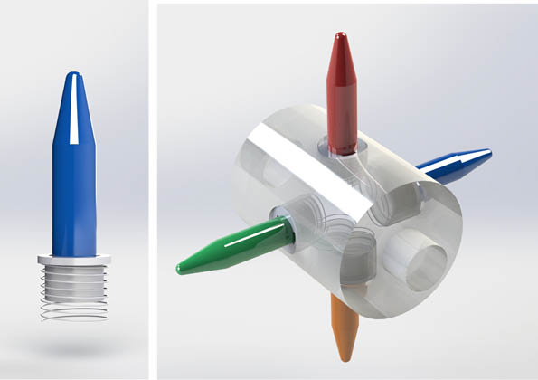
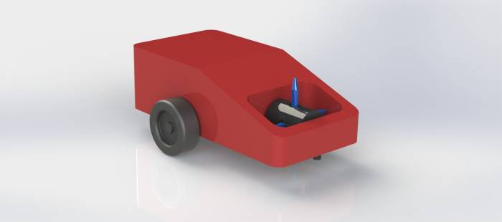
Proposed solution
Notes:
This is our proposed solution. The robot will look like the 3D model, Nona just showed you. - This is the mechanism which enables us to change the colour. It's like circle penholder which change the pen through rotation – Here we have the breadboard schematic. Here you see the microphone which detect the command given by the user. This signal is transfered to the voice recognition schield placed on the top of the Arduino. After that, those dc motors or stepper motor is activated. The infrared sensor is used to detect the end of the drawing area e.g. white paper. When the sensor detect the edge of paper, the robot will stop. We are going to use 9V battery to power all these components. Now will talk about project management...Mikko

Slide 8
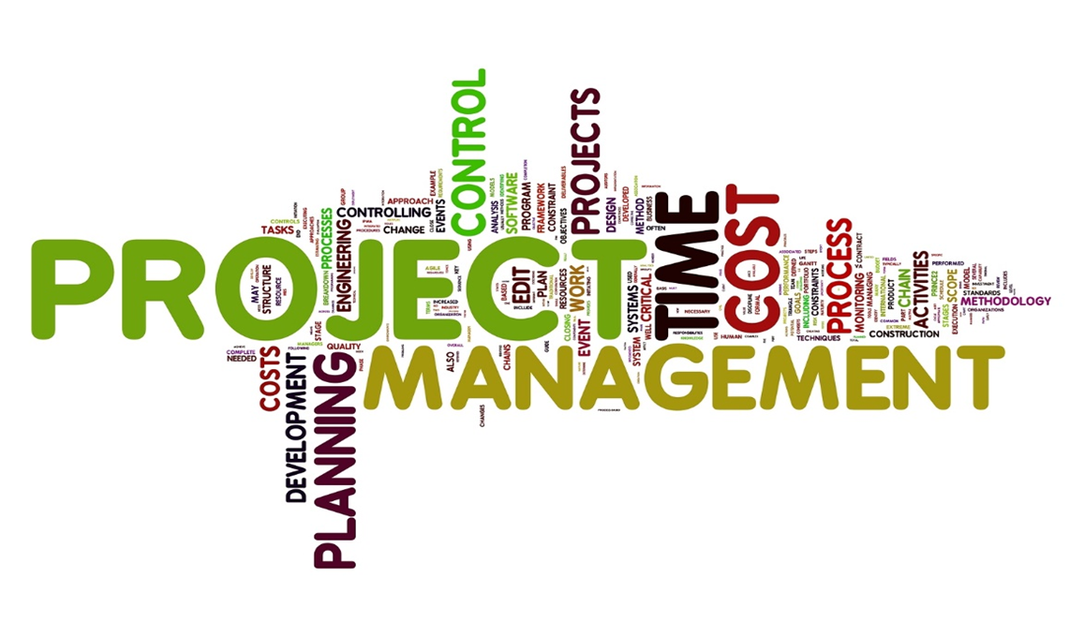
Project management
Drawbot
€ 150 budget
5 team members
1 semester
Notes:
To achieve this solution we had to do some planning

Slide 9

Ethical & Deontological Concerns
Engineering Ethics
Sales & Marketing Ethics
Academic Ethics
Environmental Ethics
Liability
Notes:
During the process of the project, we had to take into consideration the 5 categories of ethical and deontological concerns.
The most important thing was that we created everything on our own in respect to academic ethics. Above that, we followed the engineering ethics to ensure the safety of everyone involved and thanks to choosing the local providers we ensured that no exploitation of underage workers took place, protecting Liability. We tried to create a robot which is as sustainable as possible to follow environmental ethics. Regarding sales ethics, we created a user friendly Facebook page and set a fair price for our product for customers. Now we will talk about sustainabililty.

Slide 10
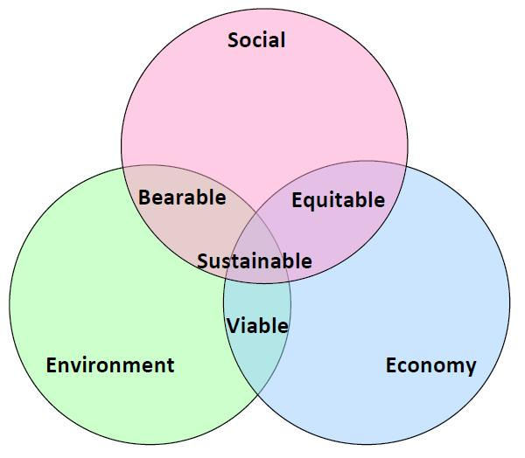
Sustainable
Enviromental
Social
Economical
Notes:
Sustainability have 3 aspects. Enviromental, Social, Economical
Eco-efficiency generates more value through technology
I think the main aspects of eco-efficiency are:
- Reduction of energy and water use
- Reduction of waste and polution levels
- Inplement the life cycle assessement
Our project can be an sustainable project because to build this prototype is using low cost materials in small quantities but the final product is amazing and it can be attractive. If our robot gona have a wood caseing will be more sustainable. In the next version of our project we can implement the solar panels in stade of the battery but we gona think about it.

Slide 11
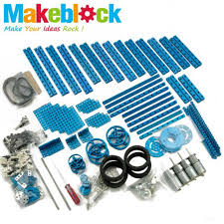
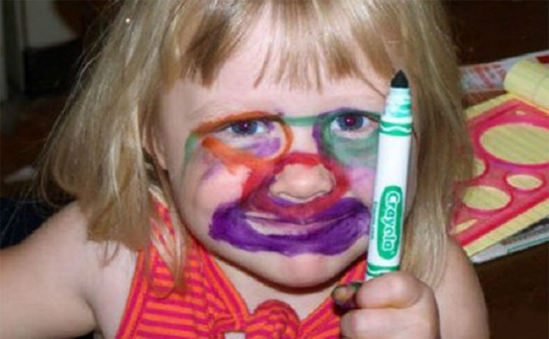
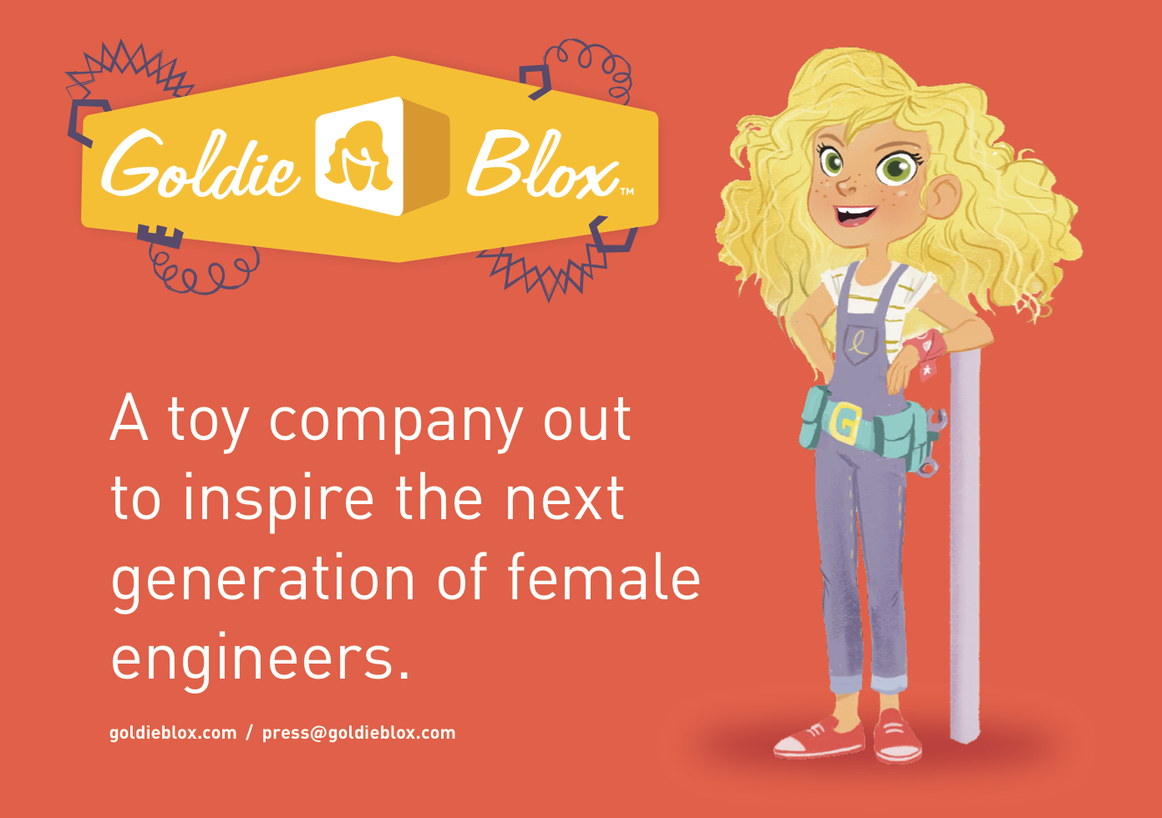
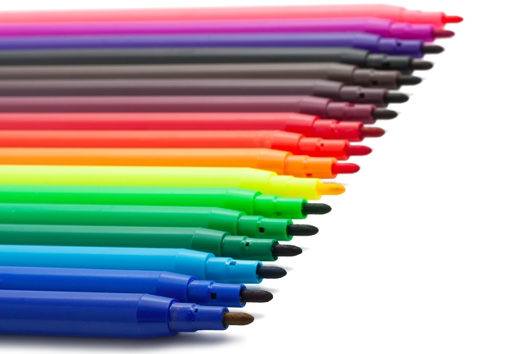
Marketing
Girls
Not a build-kit
Collectables
Notes:
As Adam already told you in the introduction, we are aiming our product at girls. With the drawbot it is impossible to draw on your face. Maybe not impossible, but at least very hard. The goal is to make girls more interested in technology, more specifically robotics. There are some companies, such as Goldieblox that are already making products for girls to develop early interest in engineering and confidence in problem-solving. This proves there is a market of conscious parents that think about the toys they buy. They do not have a drawing robot in their assortment. Furthermore there are also companies such as Makeblock that are selling drawing robots. The big difference with our competitors is that it's not a build-kit. They offer kits to build and program drawing robots, these are expensive and require some time and effort to put together. Our drawbot is ready to use and user-friendly.
We would like to make the different markers collectables.

Slide 12

Conclusion
s
Drawbot for girls
Create art
Voice recognition
Notes:
Just to summarise, we are the ones, who are going to change the worlds perception of robots.
Instead of a complicated and hard to use machine, we are working on the very first robot with aesthetical taste, designed for women. Playing with our drawbot is also interesting for men, who never obtained artistic skills, like me !
To communicate with our drawbot, you need no more than a few voice commands
the breathtaking experience begins now!

Slide 13


Questions?
Notes:
thank you for your attention, are there any questions?

