Slide 1
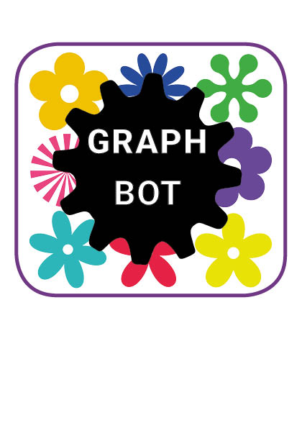



EPS@ISEP2016
Team 1
Team 1

Slide 2
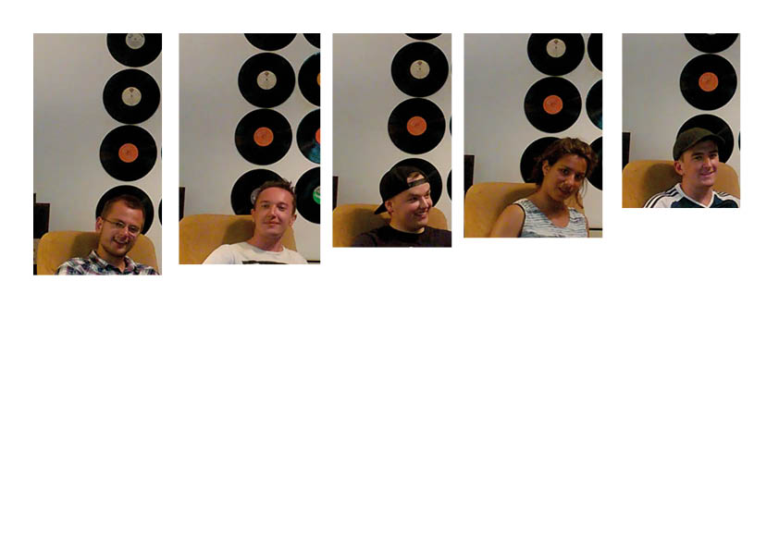
Introduction
Notes:
ADAM + EVERYONE

Slide 3
Content
Goal and idea
Design
Architecture
Project Development
Problem
Solution
Conclusion
Bonus Video
Notes:
FRASER
The main points that will be covered during this presentation are:
-Goal and ideas
-Design
-Architecture
-Project development
-Problem
-Solution
-Conclusion
-Bonus video

Slide 4


Goal
IDEA
The goal is to design, develop and build
a drawing robot, commanded through sounds or gestures.
Notes:
FRASER
The goal of the project is to design , develop and build a drawing robot which can be commanded through sounds or gestures. The idea that the team came up with to achieve the goal was to design and build the Graphbot. To make the product as sustainable and financially viable as possible, the team chose the lowest price of each component to keep within the budget set of €150 but also chose plastic as the shell material of the Graphbot which will extend the lifespan of the product.

Slide 5
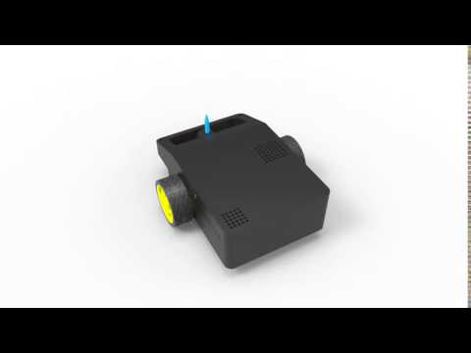
Design
Notes:
The design of the Graphbot
Two wheels and one caster ball at the back for support.
The wheel at the front with the markers on enable the user to change the color he/she is drawing with automatically
The holes on top are for the speaker and microphone, so the user can communicate easily with the Graphbot
At the side we engraved the logo of our sponsor IT sector.
The casing of the prototype is build using 3D printing. For the actual robot we will make some small changes in the design. This will make injection molding possible. This option is a lot cheaper for large quantities. For material we will use the plastic ABS.
We offer a selection of different colors. Children can add stickers to the robot and so give the robot a face.
in the future would like to implement further customization. Kids will be able to choose the color of every part of the Graphbot and make their stickers online.
Every child will have a unique Graphbot.

Slide 6
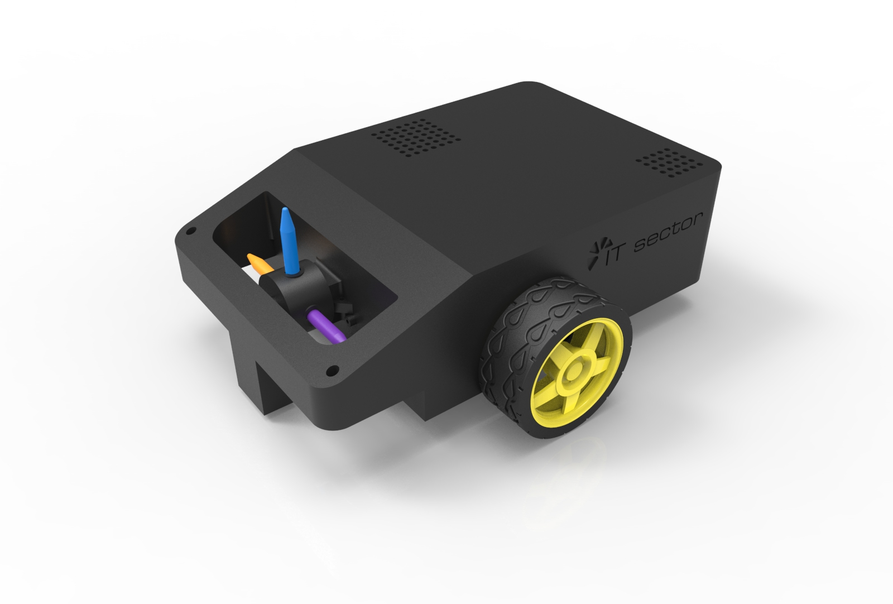
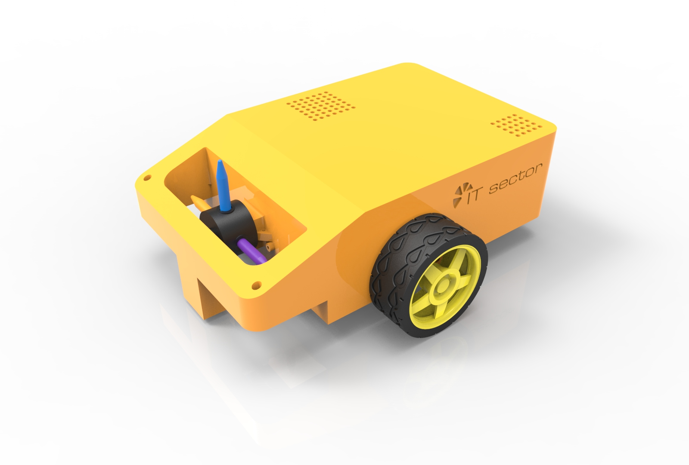
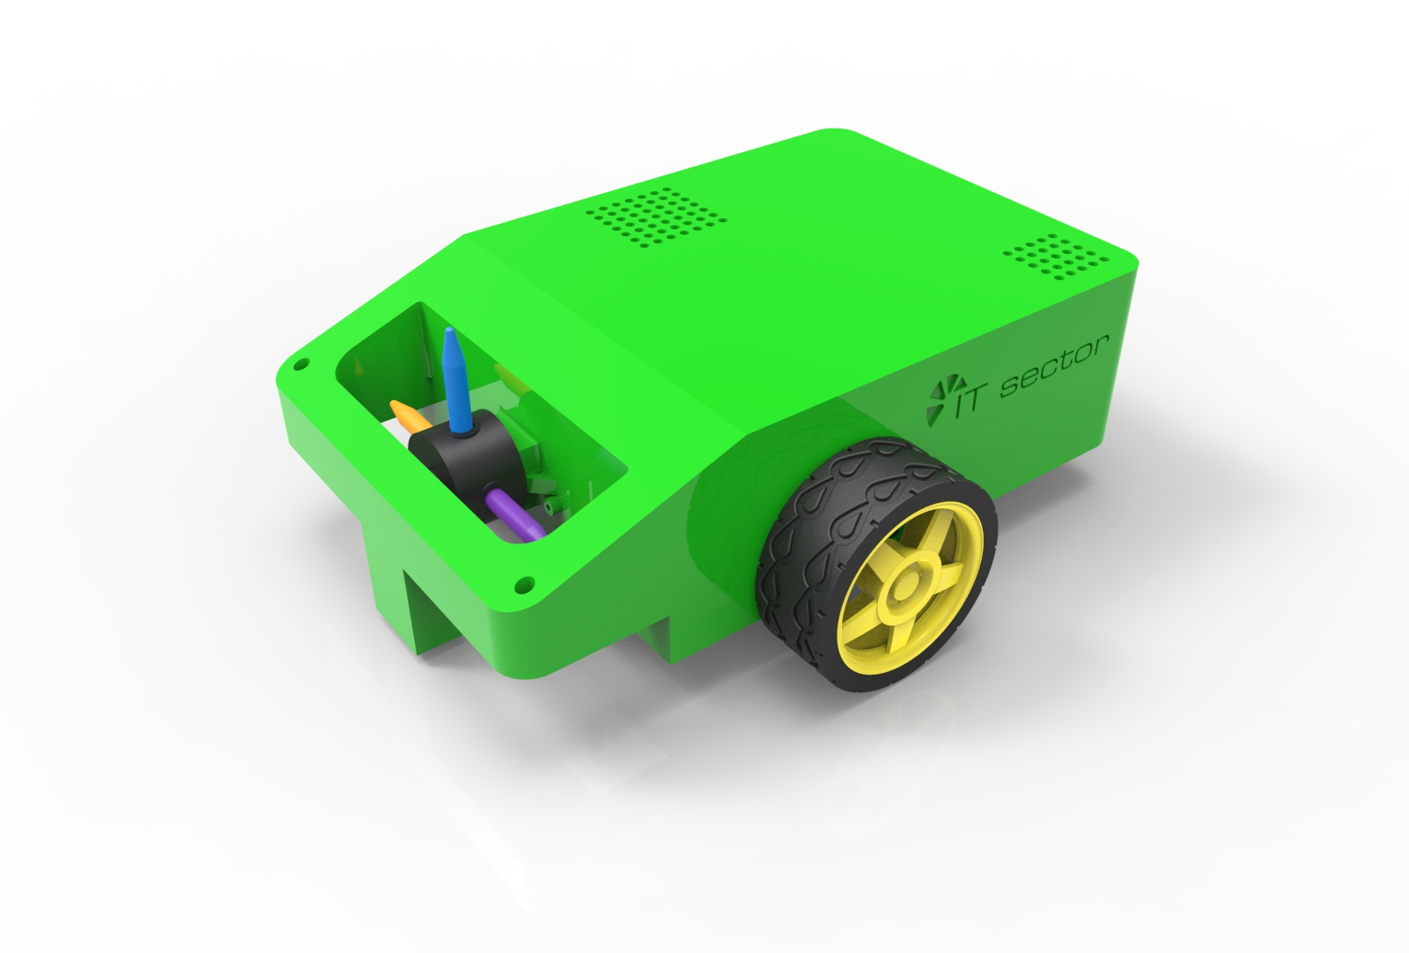
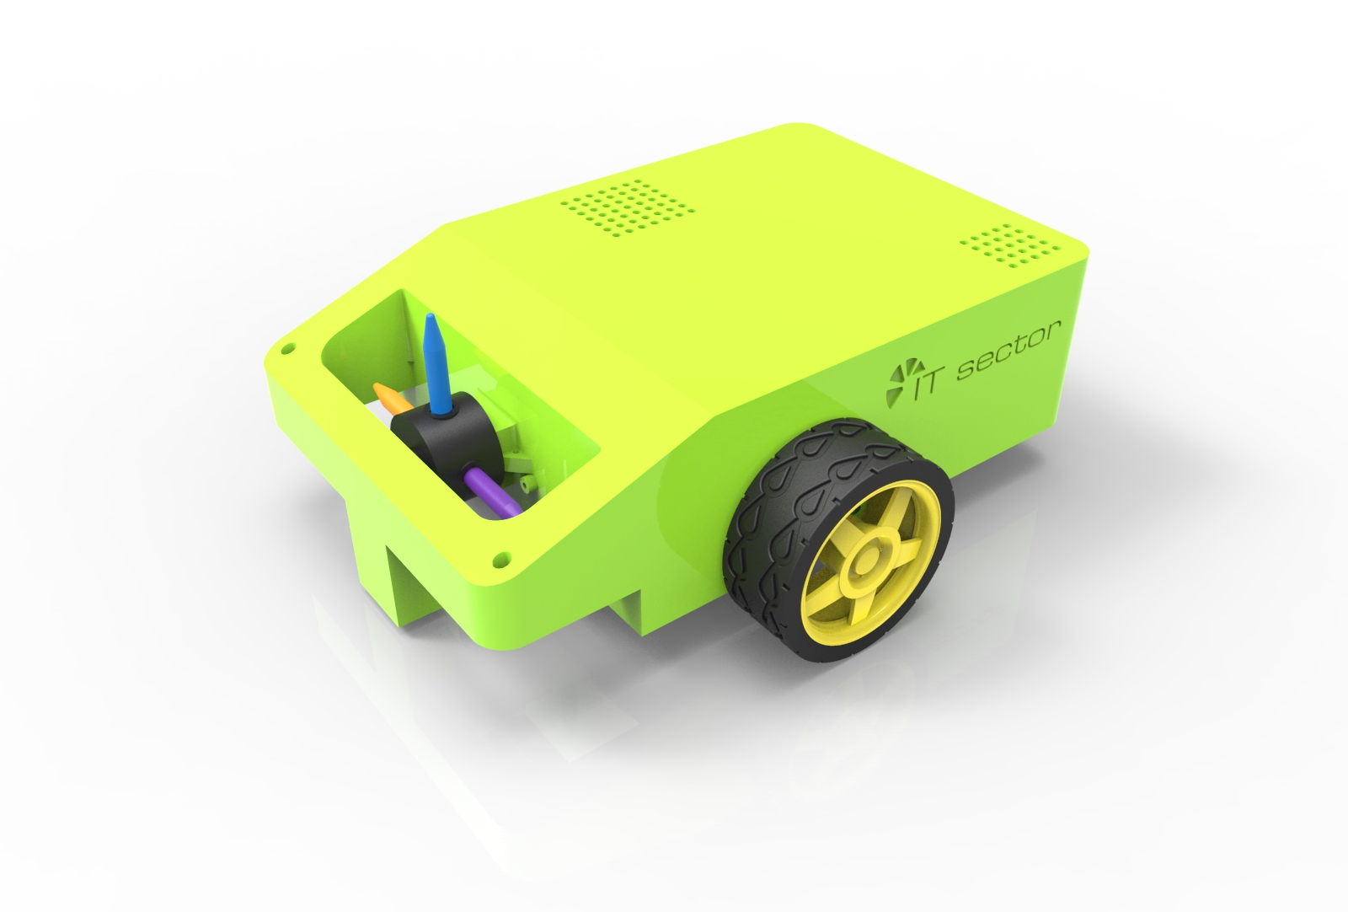
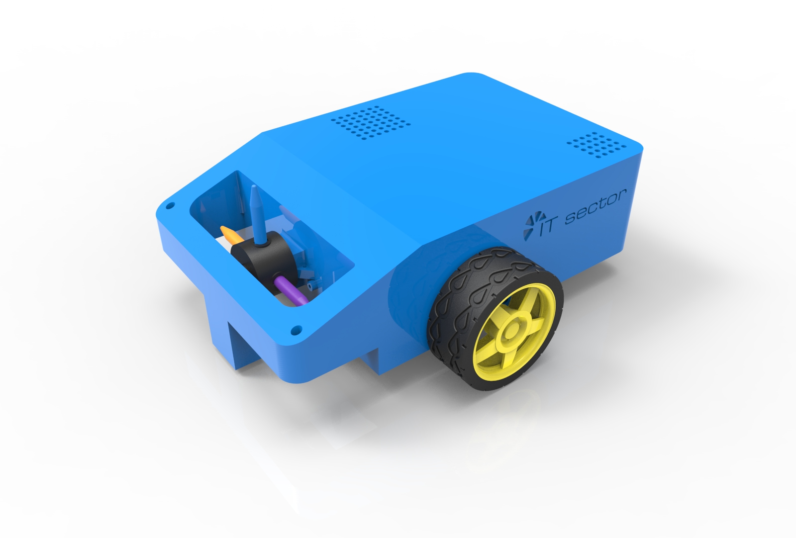
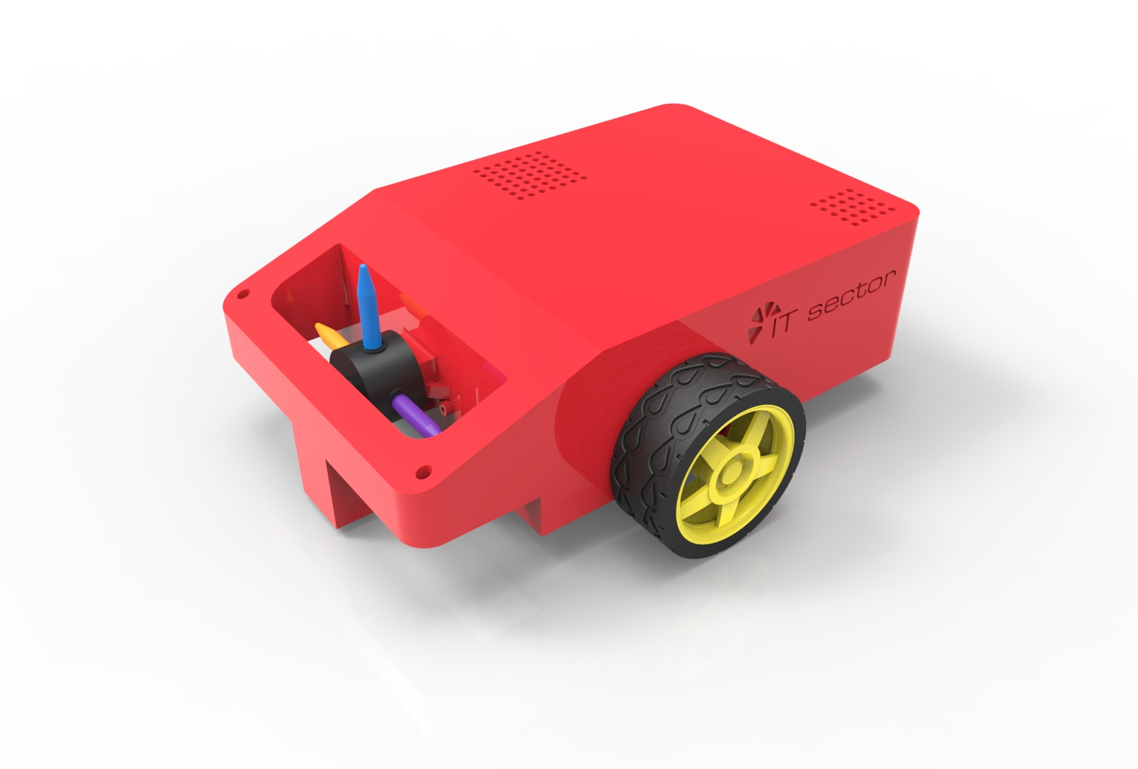
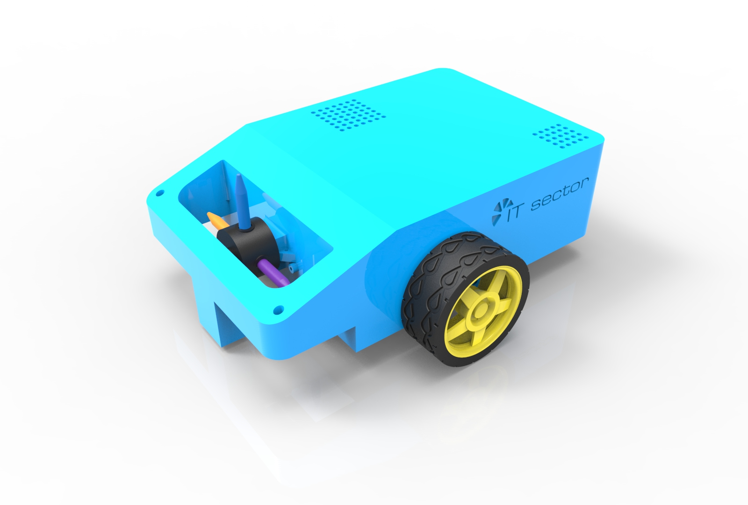
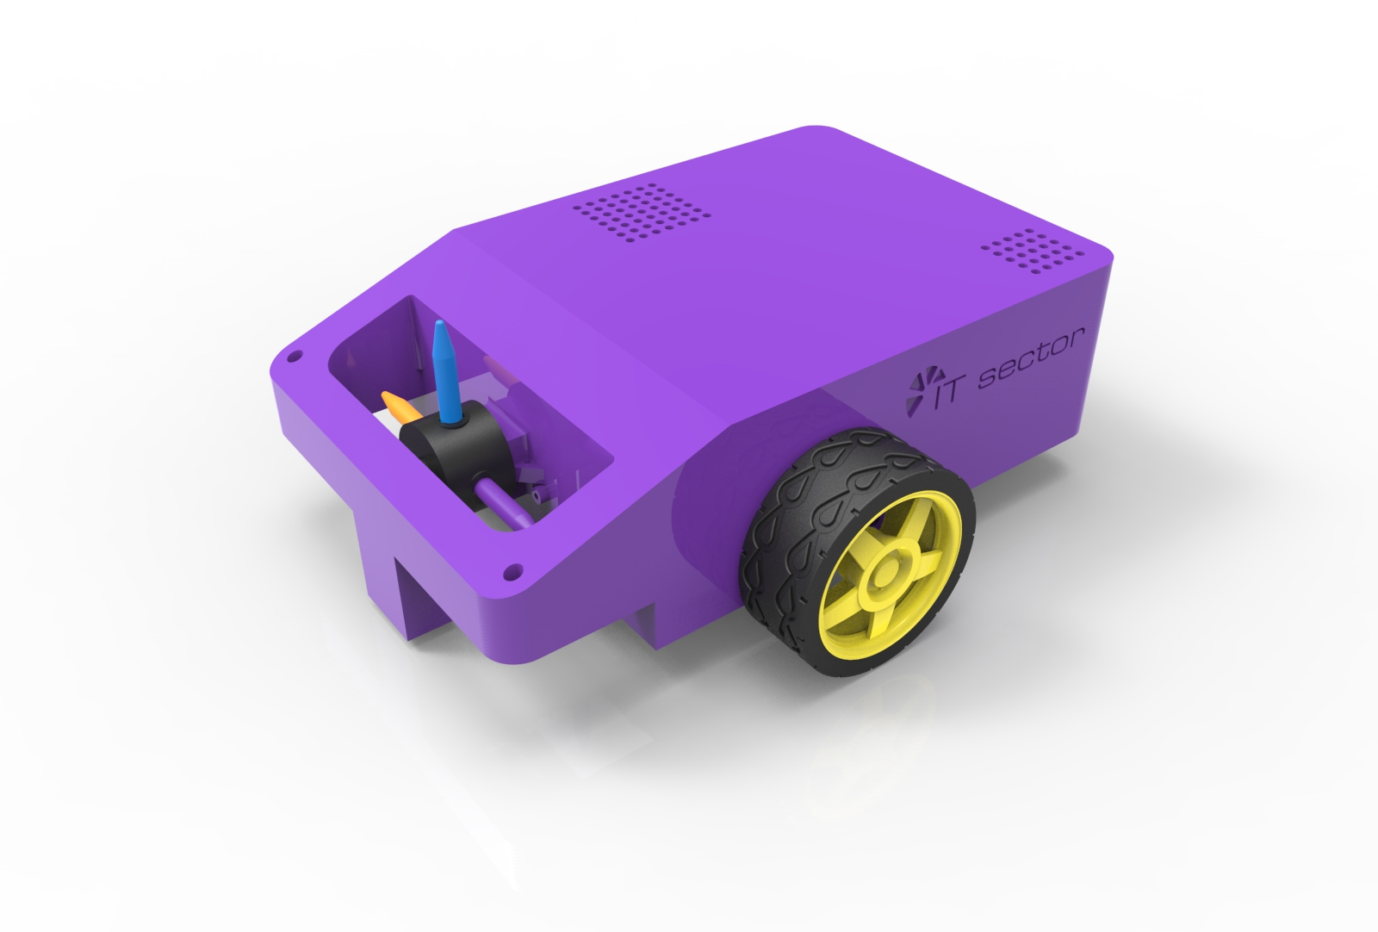

Slide 7
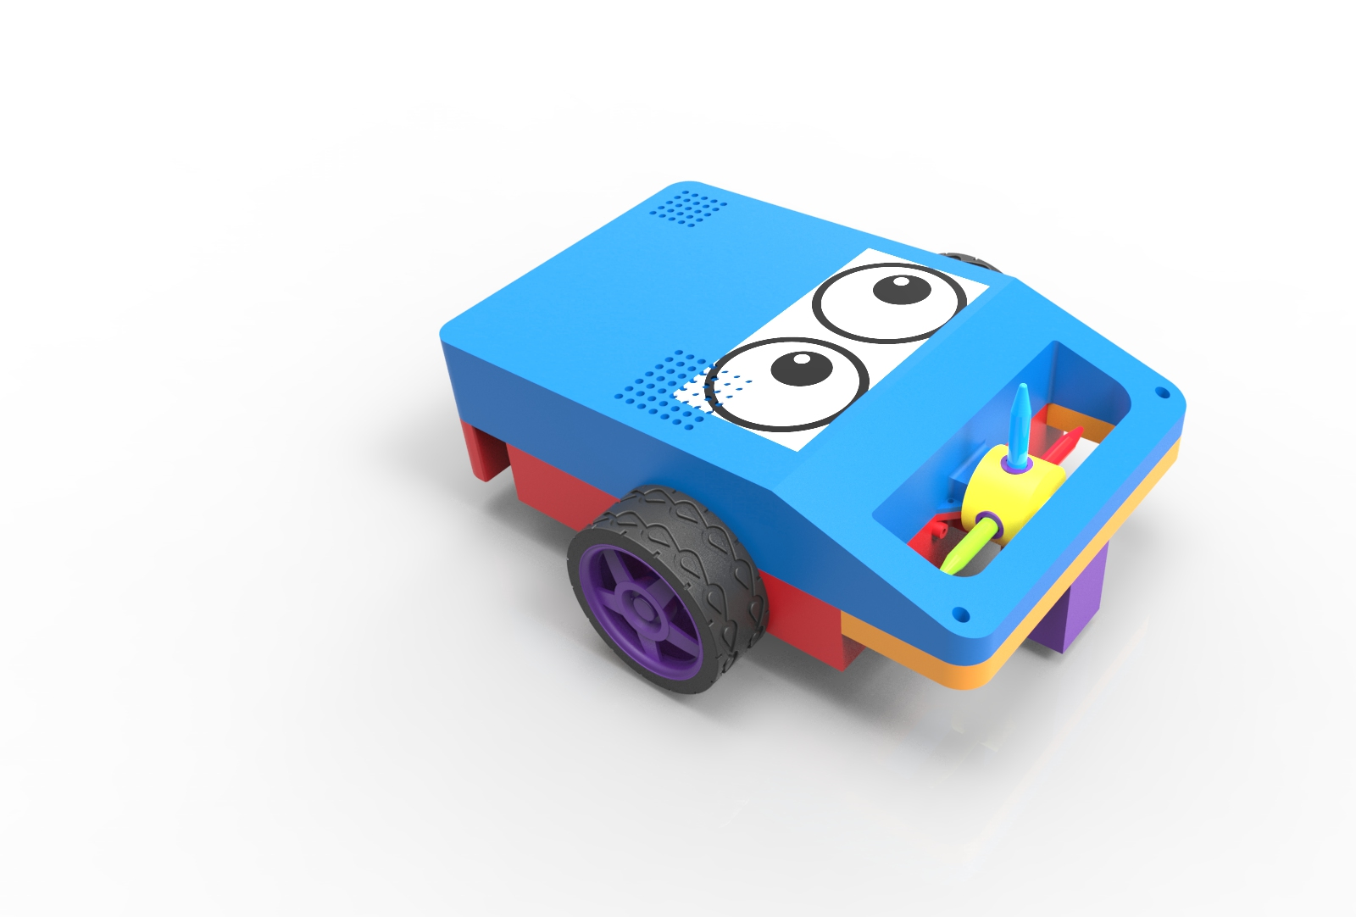
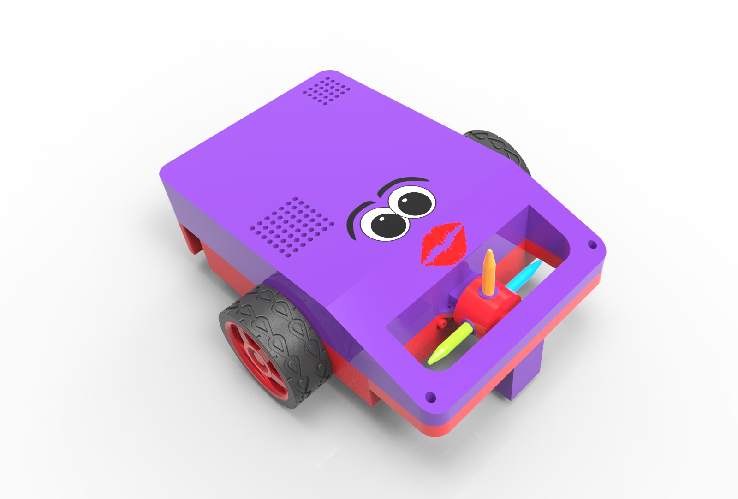

Slide 8
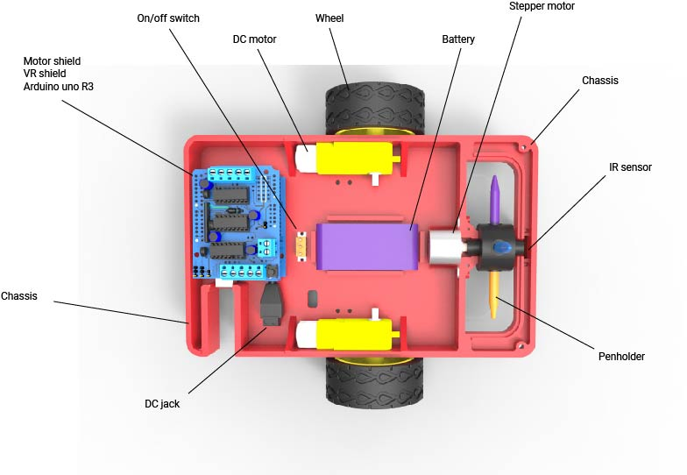
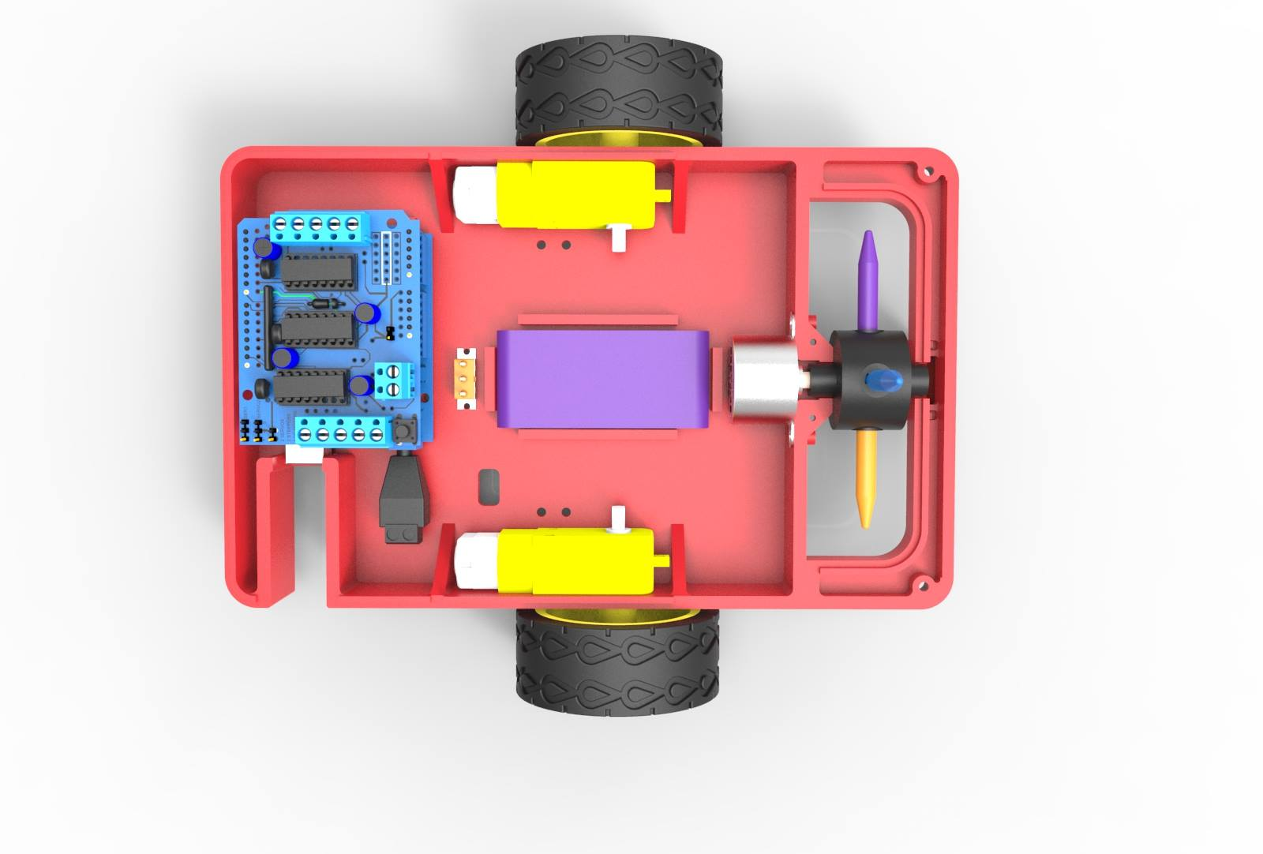
Architecture
Notes:
Regarding about architecture, this is the final version of the robot. After the meetings with the supervisors, we selected the required components to build this prototype like in the image. Because it use the voice to draw, we chosen EasyVr Shield which recognize some sounds like GO, LEFT, RIGHT, and this shield is connected on the top of Arduino. For movement of the robot, it 's using 2 DC motors , the robot is able to change the colour using a stepper motor. To command all of these motors, we need a Motor Shield placed on the top of EasyVr Shield. To power up all of these components, it gonna use a Polymer Lythium battery placed in the middle of the chassis. After the discussions regarding of design of the chassis, it's using the plastic, because it's easier to create it with a 3D printer for what shape you want. The robot can detect the paper with the help of IR sensor mounted in the front.

Slide 9
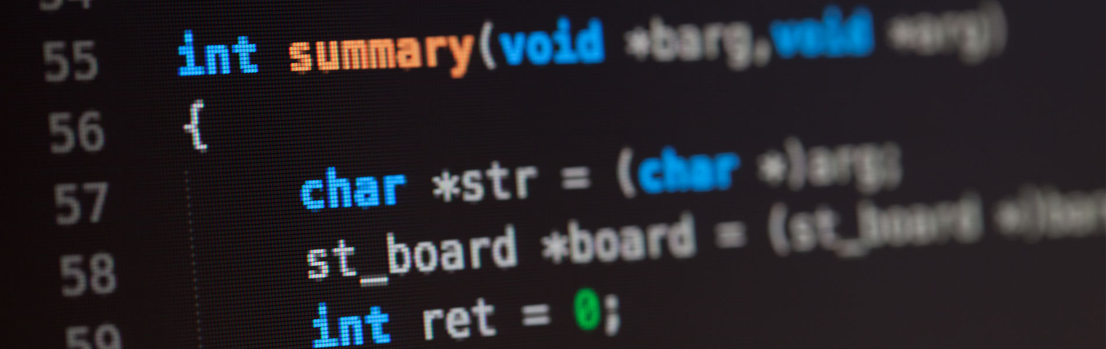
Project Development
Notes:
Adam

Slide 10
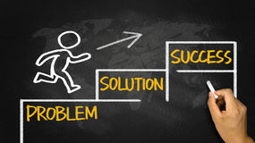
Problems
Notes:
Mikko -

Slide 11
Solutions
<here DEMO video>
Notes:
video

Slide 12

Conclusion
Solar powered
Notes:
Future developpers should consider implementing solar panels. This could extend the usage period tremendously, leading to infinite fun for the kids.

Slide 13
Bonus Video
Notes:
video

